Slide 1




DOO
DOO
IT
IT

Slide 2
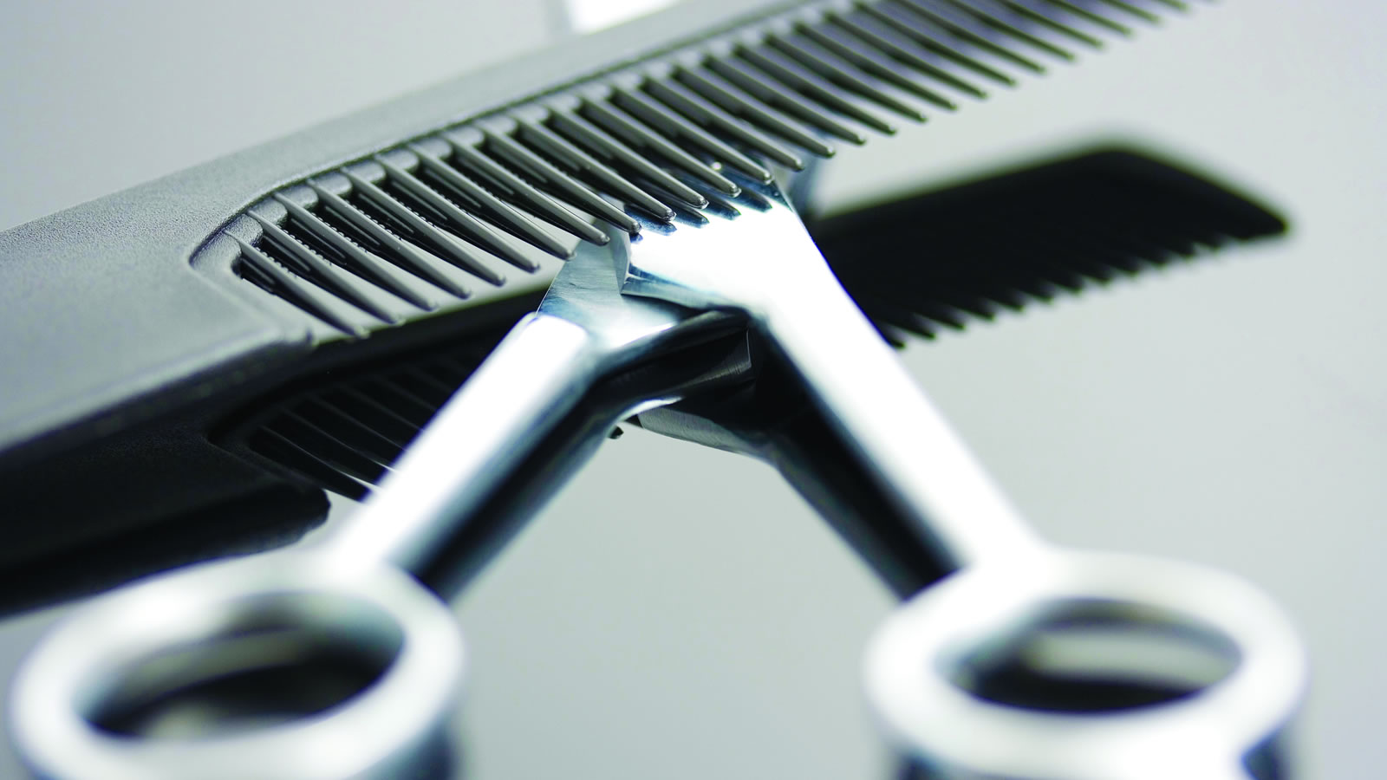

Origins

Slide 3


Notes:
Skyla

Slide 4
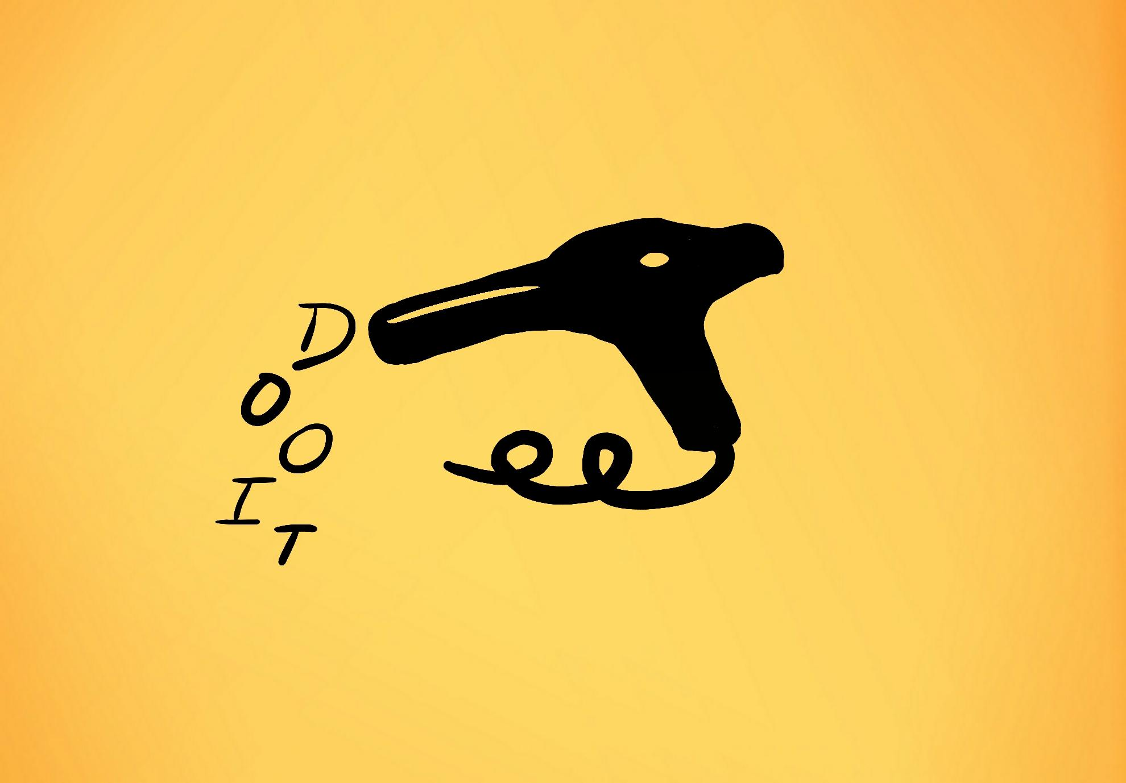
Notes:
Thats a placeholder for the actual DOO-IT logo

Slide 5


Personal
Business

Slide 6
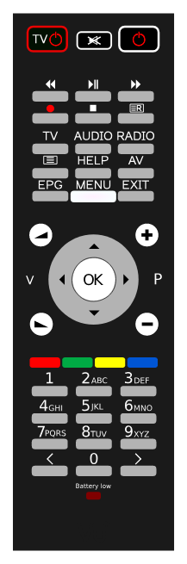
Take
Control

Slide 7

Features

Slide 8


01
Hair Overlay

Slide 9

01
Hair Overlay
Advanced A.I
02

Slide 10

01
Hair Overlay
Advanced A.I
02
03
Video Tut.

Slide 11

01
Hair Overlay
Advanced A.I
02
03
Video Tut.
Challenges
04

Slide 12

01
Hair Overlay
Advanced A.I
02
03
Video Tut.
Challenges
04
05
Bookings

Slide 13

01
Hair Overlay
Advanced A.I
02
03
Video Tut.
Challenges
04
05
Bookings
Hair Wall
06

Slide 14

Actual Image of Segger
11/16/2018

Slide 15


Slide 16



Slide 17

Business

Slide 18

Exposure

Slide 19

$
$15,600
Lost/Year

Slide 20

Exposure
Booking

Slide 21

Exposure
Booking
Ratings

Slide 22

Pricing

Slide 23


+ Premium
$24.99
Premium
Basic
Business
$0.00
$199.99

Slide 24

Profits

Slide 25
236,625,329
Possible Users in Canada and USA (15-60 years of age)
Notes:
Skyla

Slide 26
106,000
Possible Businesses in Canada
Notes:
skyla

Slide 27
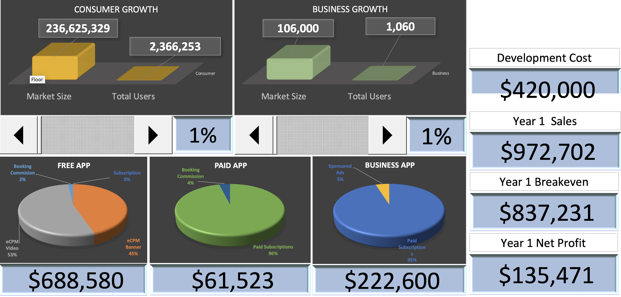
Notes:
Skyla
Close to 1 mil but breakeven is also close to 1 mil so not much profit

Slide 28
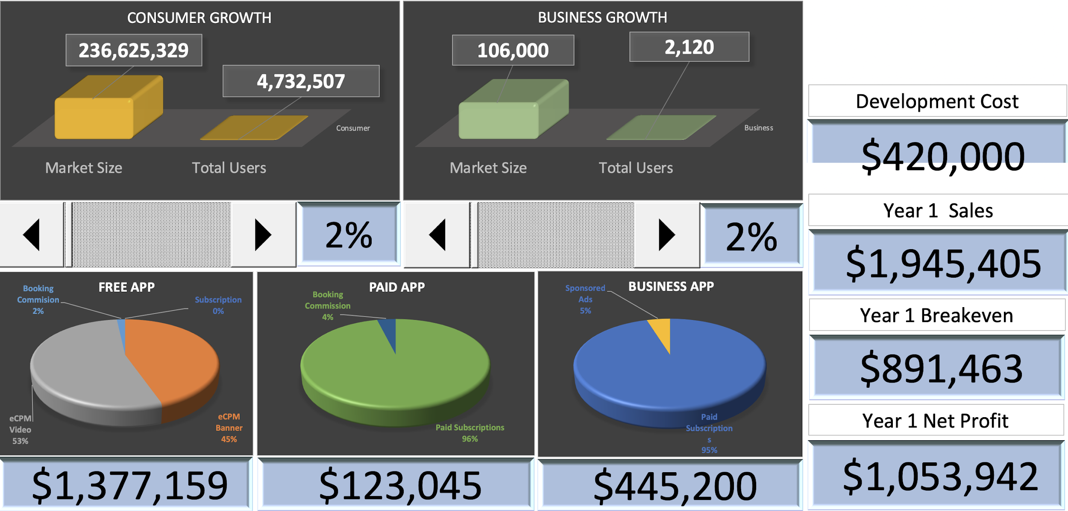
Notes:
2 mil in sales by just an increase of 1%

Slide 29
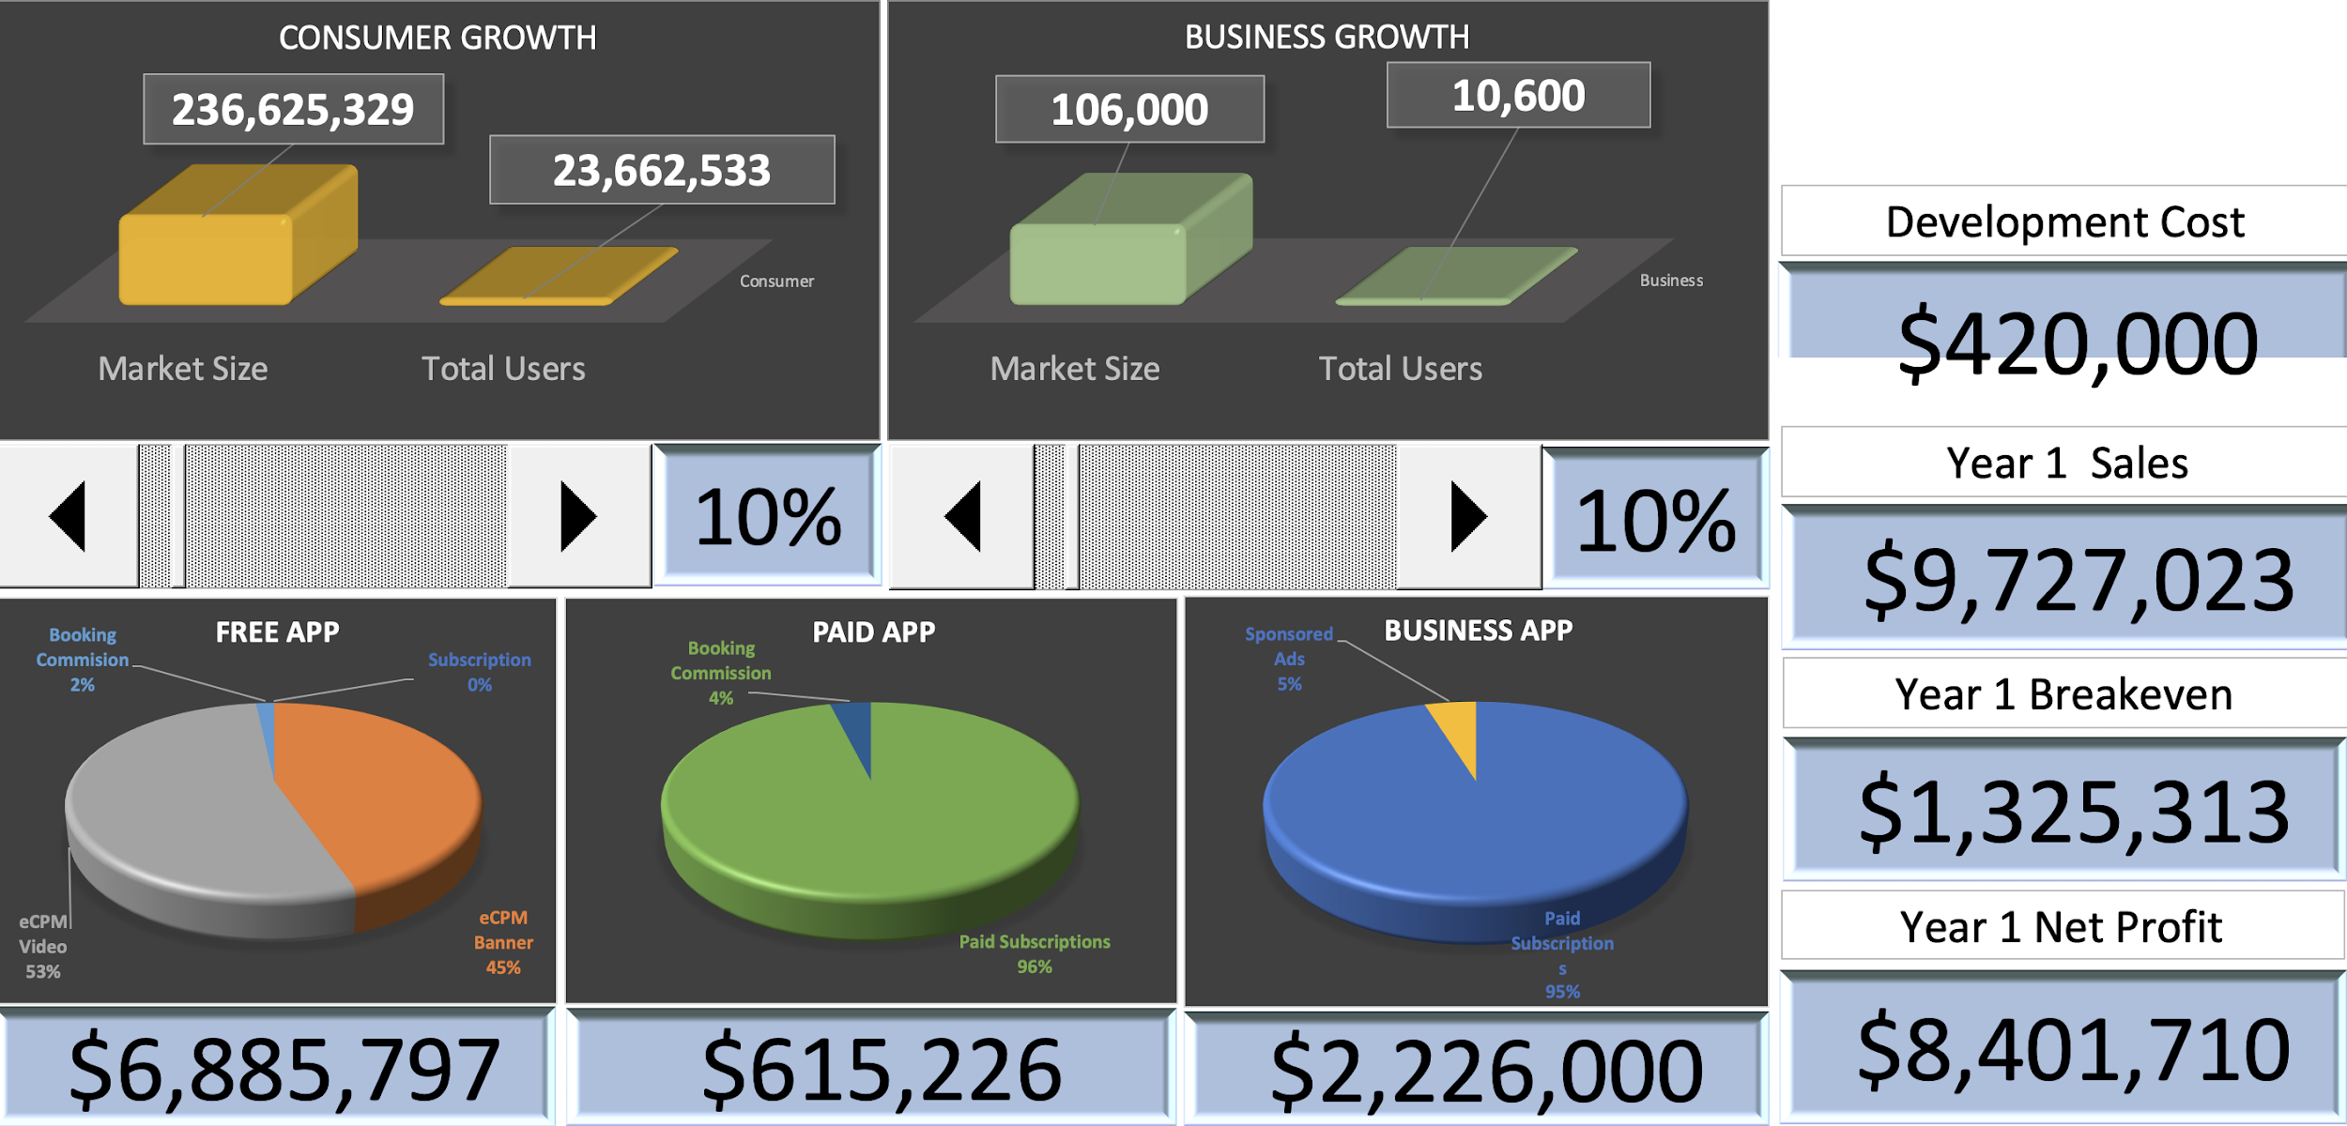
Notes:
Skyla
10 mil can be made after a few years in business
Quick to make money
Business will always grow

Slide 30

Future

Slide 31
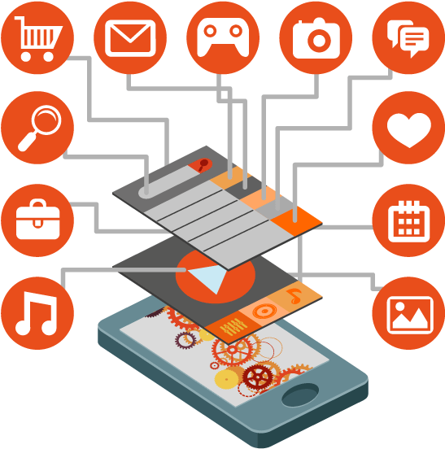



Investors
Development
Present
3 Months
15 Months
18 Months
Employees
Testing

Slide 32
Thank you very much.
https://khronis.github.io | khronisOrganization@uOttawa.ca | 1337 Ocean View Parkway, San Francisco | (613) 197-6042

